Slide 1
FINANCE PORTFOLIO
PROJECT
Reporters: Jason, Ekko, Jolson, Joey
Date: 2025/8/1
Notes:
# JASON
Good afternoon everyone! We are group 6. Today, I’m excited to present out Portfolio project which is a smart investment management platform designed to help users to track, and grow their wealth.

Slide 2

CONTENTS
01
02
03
04
TEAM INTRODUCTION
OUR
PROJECT
TECH& SUMMARY
AHEAD
ROAD
Notes:
# JASON
Here is the brief contents of our presentation.

Slide 3

PART ONE
1
TEAM INTRODUCTION
Notes:
# JASON
Please allow me to introduce our team firstly.

Slide 4

TEAM INTRODUCTION
IWPB Department
Wealth & Perm Solution Tech
Digital
Platforms
Wealth & Perm Solution Tech
Wealth & Perm Solution Tech
Notes:
I am XXX,
I am EKKO Zhong from the Mobile team of the IWPB department, and I'm in charge of the front-end work of the project.

Slide 5
PART TWO
2
OUR
PROJECT
Notes:
# JASON
Our project is a comprehensive portfolio management system designed to simplify stock trading and asset tracking. It’s not just a tool; it’s your personal finance hub. Let me walk you through how it works.

Slide 6

PORTFOLIO PROJECT
SYSTEM FLOW
SYSTEM
WALKTHROUGH
DEMO
Notes:
# JASON

Slide 7
SYSTEM FLOW
Login
Register
Home
Stock Repositories
Portfolio Management
Info Chart
Detail
Info
Asset Allocation
Asset Details
Notes:
# JASON
Our user journey begins with a simple login page—new users can quickly register an account before signing in.
Upon successful authentication, you'll arrive at your personalized dashboard, the central hub for all financial activities.
From here, our users will be navigated to explore real-time stock repositories with detailed analytics and interactive price charts, or dive into portfolio management to track assets, review allocations, and analyze performance metrics, and they are all designed for intuitive, data-driven decision-making in one streamlined workflow.
Building on what we’ve just seen, let’s explore the exact pages of the portfolio project.

Slide 8
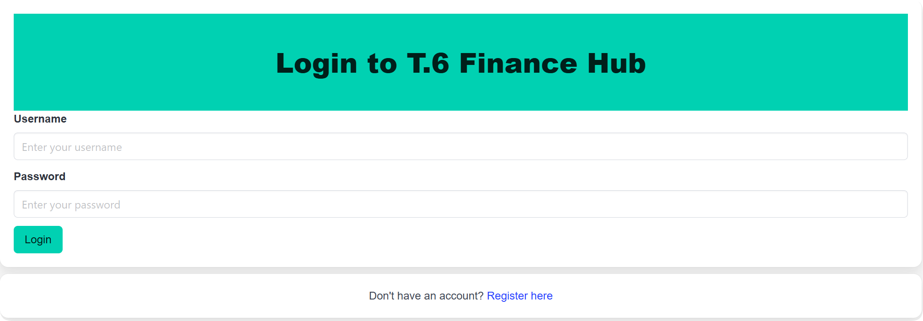
SYSTEM WALKTHROUGH
请在此处添加标题文字
点击此处添加页面标题内容
点击此处添加页面标题内容
点击此处添加页面标题内容
点击此处添加页面标题内容
请在此处添加标题文字
点击此处添加页面标题内容
点击此处添加页面标题内容
LOGIN PAGE
Notes:
# JASON
Alright, let’s start with the login page. Here, users just type in their username and password to sign in. If you don’t have an account yet? No worries—there’s a handy link at the bottom that says, ‘Don’t have an account? Click here to sign up! Super easy.

Slide 9
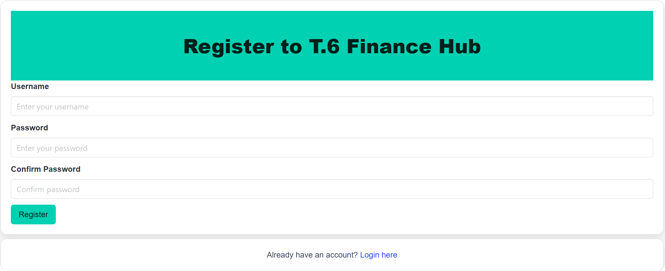
SYSTEM WALKTHROUGH
请在此处添加标题文字
点击此处添加页面标题内容
点击此处添加页面标题内容
REGISTER PAGE
Notes:
# JASON
Clicking that link takes you to the registration page. All you need to do is input a username, set a password, and type it again to confirm. Click ‘Register,’ then you’re all set!

Slide 10
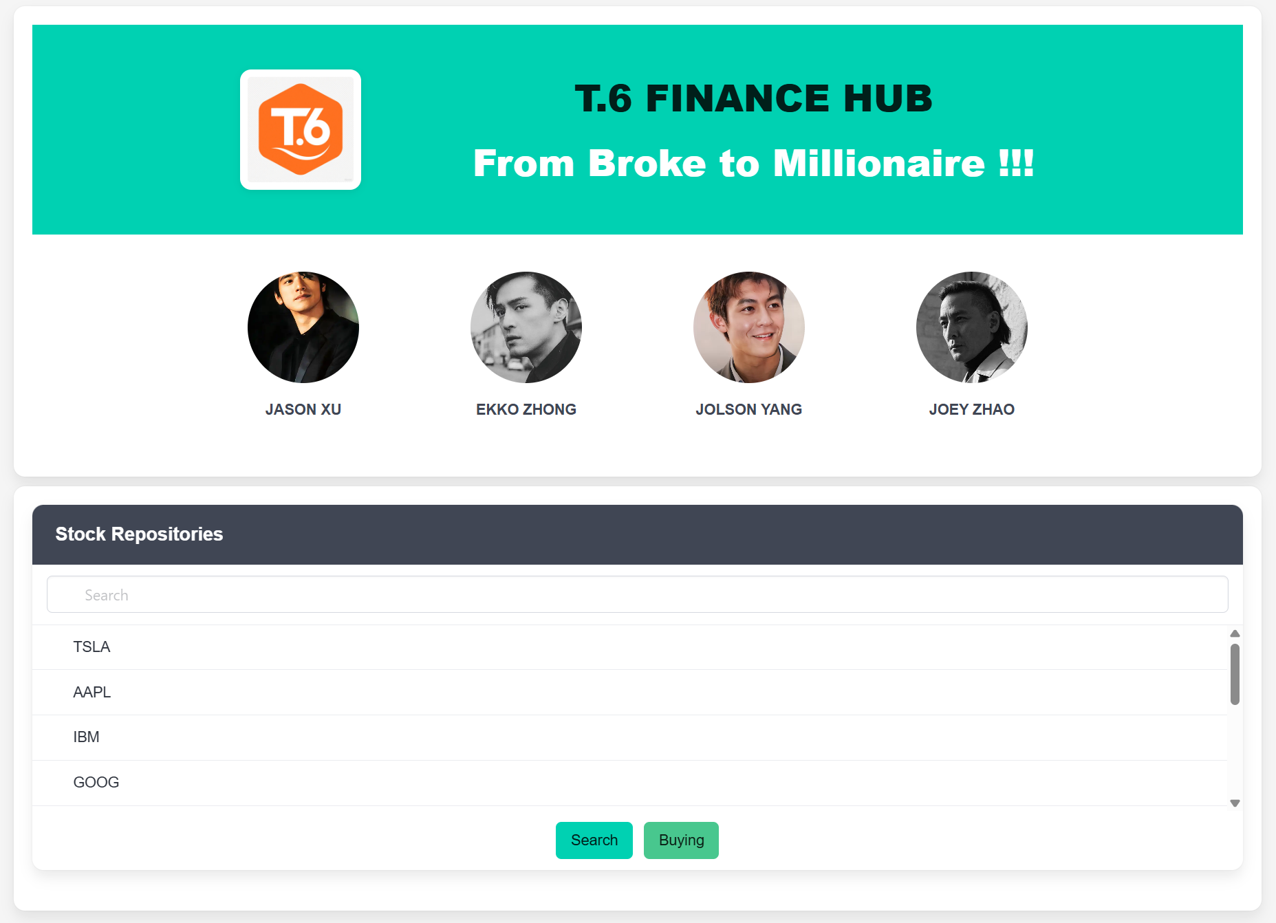
SYSTEM WALKTHROUGH
BRAND
SECTION
STOCK
REPOSITORIES
Notes:
# JOEY
Once you’re logged in, you'll land on the homepage.
// Brand Section
You can search for any stock you're interest in or pick one from the list. And then just click 'Submit' to check it out.

Slide 11
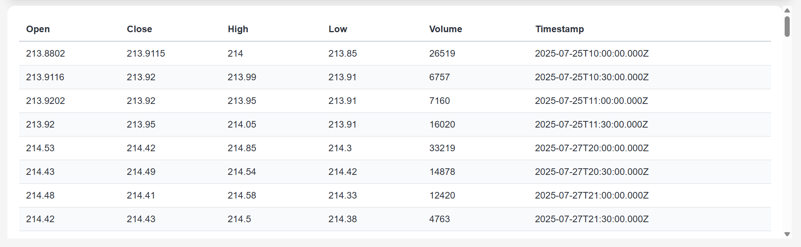
SYSTEM WALKTHROUGH
DETAILED
INFOMATION
Notes:
# JOEY
After pick a stock, the page shows you all the key details—like the open price, close price and more.

Slide 12
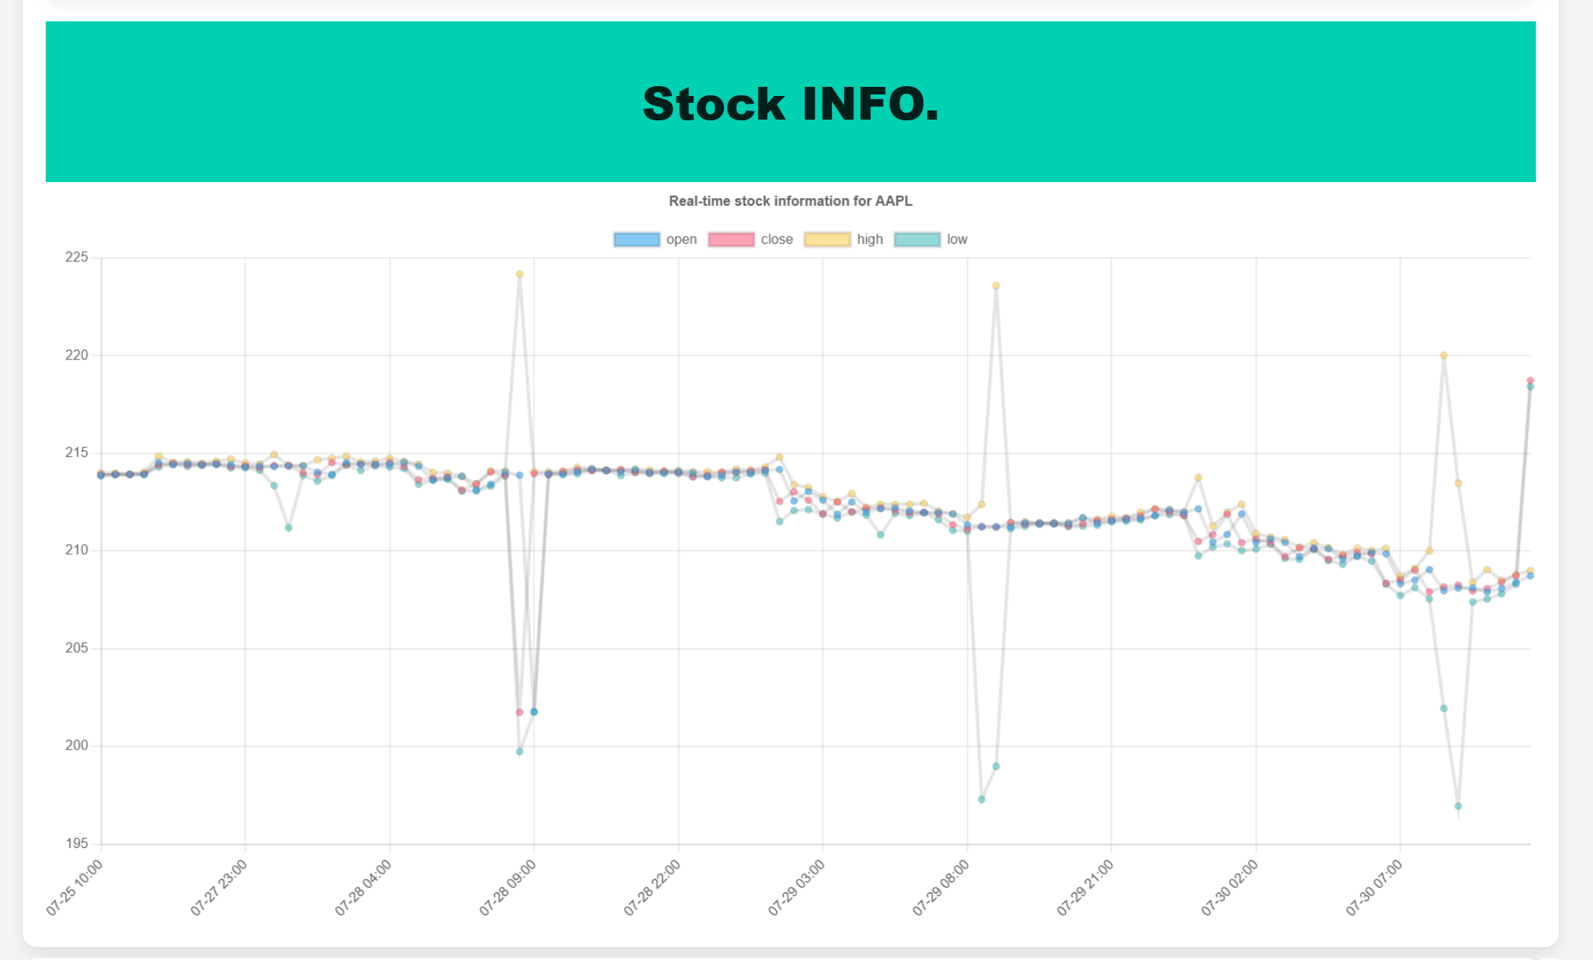
SYSTEM WALKTHROUGH
STOCK
LINE
CHART
Notes:
# JOEY
But numbers alone can be boring, right? That’s why we added line chart. It allows users to see how the stock’s price has changed over time.

Slide 13
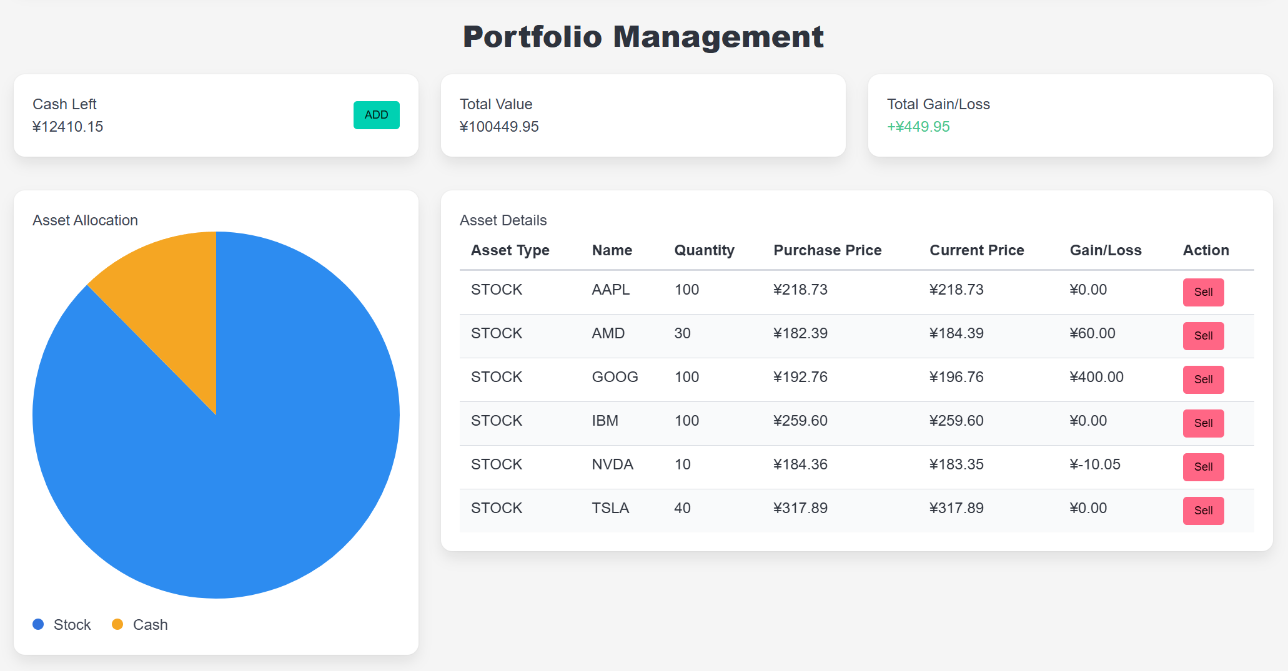
SYSTEM WALKTHROUGH
GENERAL
VIEW
PIE CHART
Notes:
# JOEY
Now, let’s talk about portfolio management.
In the above Section, you can see the General View of your stocks. How much cash do you have left, your current total assets, and your current total profit or loss.
The lower left corner is a pie chart showing the proportion of cash and stocks.

Slide 14
SYSTEM WALKTHROUGH
STOCK
DETAILS
SELL
Notes:
# JOEY
The lower right corner contains the information of the stocks you currently hold.
You can choose to hold on or sell directly

Slide 15
DEMO
DEMO PART
Notes:
# EKKO
Here’s a quick demo. After logging in, users land on the Home screen, where they get an overview of their investments. The Stock Repositories section offers real-time data and search functionality. Portfolio Management lets users adjust holdings, while Info Charts visualize performance. Every feature is built for clarity and action.

Slide 16
PART THREE
3
TECH & SUMMARY
Notes:
# EKKO

Slide 17
TECH
/tab_six/login
/tab_six/mysql/init
/tab_six/mysql /create-tables
/tab_six/stock/update
/tab_six/stock/delete
/tab_six/stock/getFromDB
/tab_six/stock/getLastFromDB
/tab_six/stock/ external
/tab_six/exchange/buyingIn
/tab_six/buyingOut
/tab_six/position/get
Database
Import & Query
Data
External API
Query
Backend
Data
Internal API
Data
Request
PROJECT
ARCHITECTURE
Frontend
Event
UI
Notes:
# JOLSON
Here is our system's architecture . At the heart of everything is our Database, where all account details and stock data are securely stored. And it constantly exchanges information with our Backend. The Backend also talks to External APIs for real-time stock data. What you actually see and interact with lives in our Frontend and UI. And every button click triggers specific Internal API calls to get the data.

Slide 18
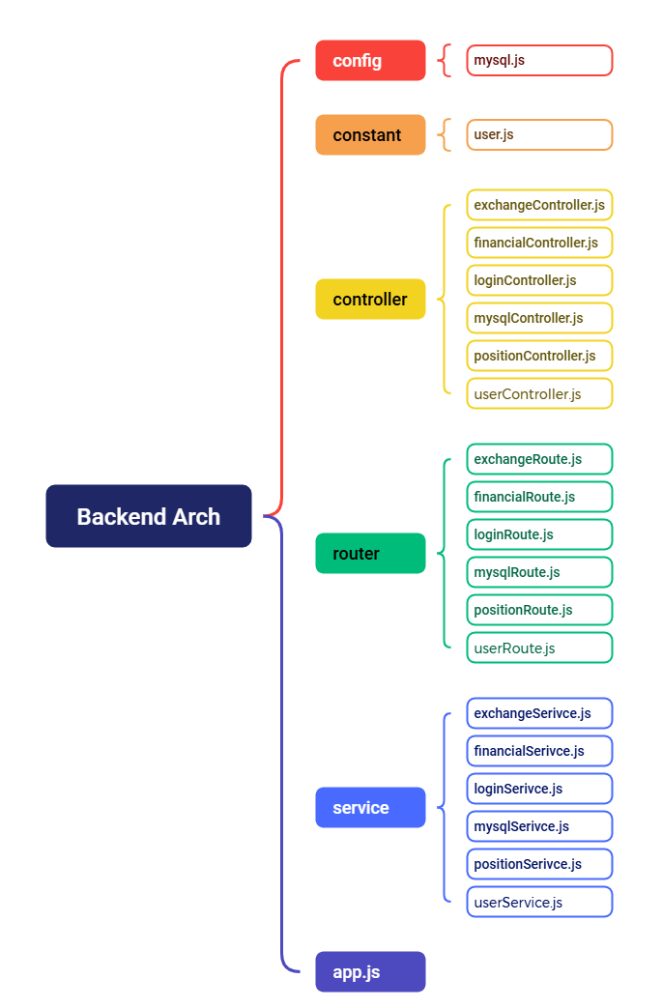




TECH
Backend Stacks & Arch
Javascript
Express
Axios
Mysql2
Notes:
# JOLSON
This is our backend setup—the engine that keeps everything running smoothly. On the left, you’ve got our core tools: **JavaScript** as our coding language, **Express** for building the framework, **Axios** to fetch data from external sources, and **MySQL2** to handle all our database conversations.
Now, check out the right side—this is where the real organization happens. At the top, we’ve got **config** and **constant** files, they are defined as rulebooks. `mysql.js`sets up our database connection, while `user.js`define a user class.
Next, the **controllers**—these are like the managers of our app. Each one handles a specific task: `loginController`checks user credentials, `exchangeController`processes trades, and `financialController`crunches the numbers.
Below them, the **routers* make sure every request goes to the right controller. And each controller has its own matching route,it keeps things clean and efficient.
Then we’ve got the **services**—the real workhorses. They take requests from the controllers, response for these requests, and send back the results.
So, the backend workflow is : request comes in → router directs it → controller decides what to do → service does the work → and return the data.

Slide 19
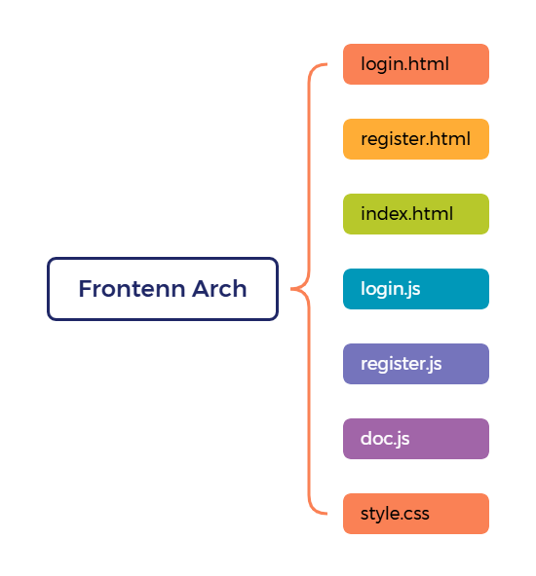



TECH
Frontend Stacks & Arch
Html
CSS
JavaScript
Bulma
Notes:
# EKKO
Alright, let's break down our frontend setup—it's super straightforward! On the left, we've got our core building blocks: HTML for structure, CSS for styling, JavaScript for all the smart functionality , and Bulma as our secret weapon for style designs. Now check out the right side,we've got key pages like login.html, register.html, and index.html,each html page is paired with their JavaScript buddies.

Slide 20
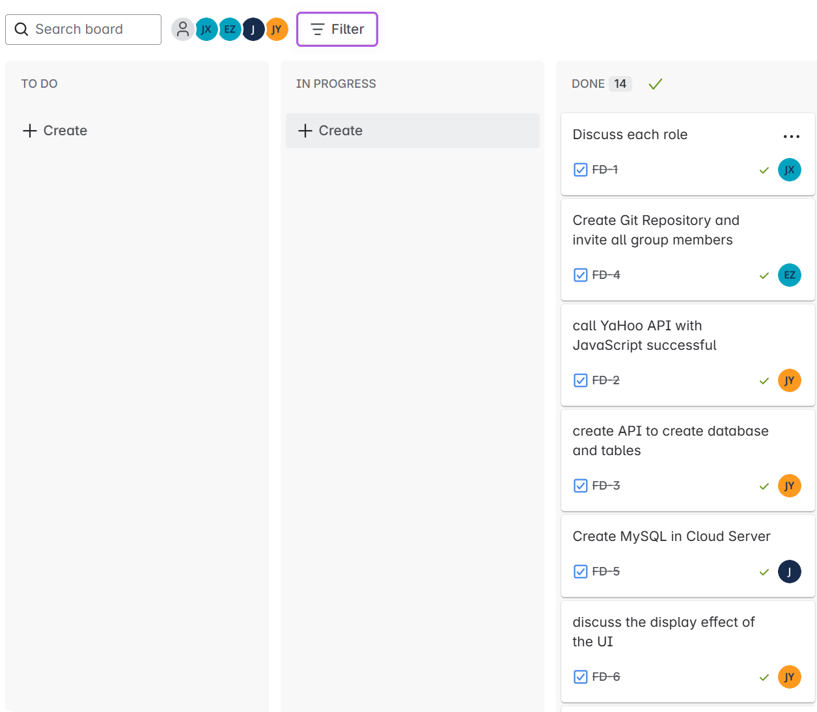
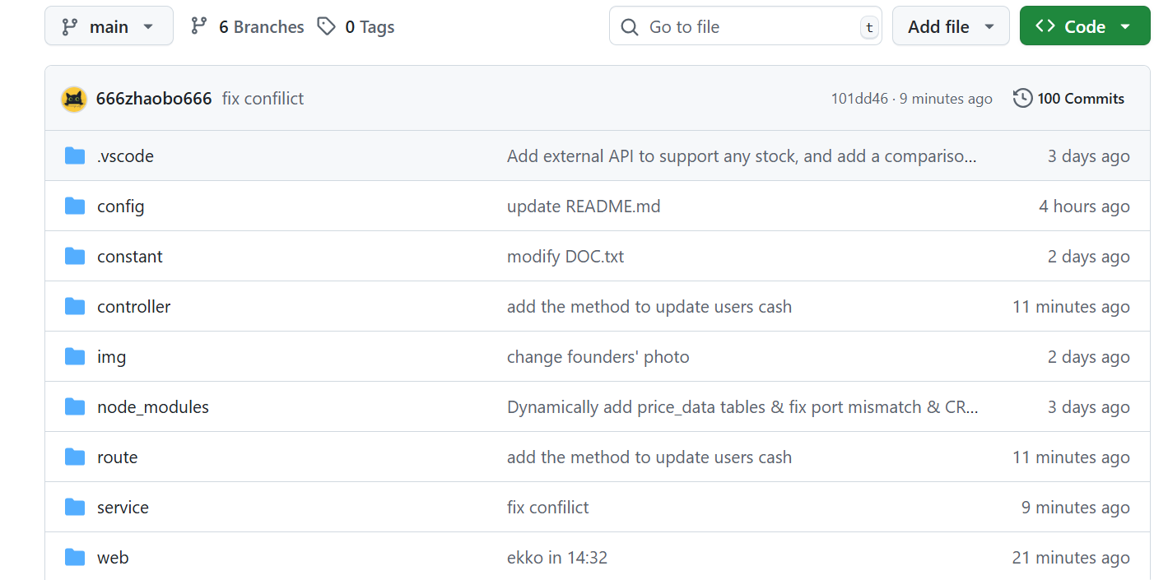
SUMMARY
Collabs: Git & JIRA
Notes:
# JOEY
For our code collaboration, we use Git - that's where we all commit our changes and keep everything organized. And to make sure we're all on the same page with tasks, we use Jira to assign who's doing what. It's like having a digital project manager that keeps us all aligned and moving forward together!

Slide 21
SUMMARY
Punctuations
. Dot
, comma
? question mark
: colon
; semicolon
/ slash
! exclamation mark
() parentheses
[] square brackets
{} curly brackets
Learned Techs & Others
Networking
Linux
SQL
JavaScript
Html
CSS
Generative AI
Web
Techs
Notes:
# JOEY
This page is showing out summary, it's all about the tech stacks we use in backend and frontend. And the most important things that we learned in this class:Tobias and the punctuations.

Slide 22
PART THREE
4
AHEAD ROAD
Notes:
# JOEY
Next, let's talk about where we're heading next with this project!

Slide 23




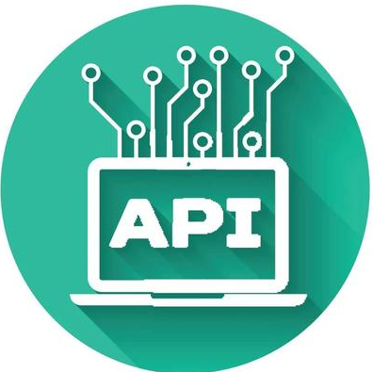
AHEAD ROAD
MORE FEATURES
DATABASE
MORE ASSETS
MORE DETAILED INFORMATION
SECURITY
DB STRUCTURE
USER CONTROL
API
IMPORVE USER MANAGEMENT
OFFER MORE CONVENIENT FEATURES
GET MORE INFOS FROM EX API
INFO CACHE SYSTEM
Notes:
# JOEY
firstly, more features – We're adding more assets and more detailed infos to give users everything they need in one place.
secondly, sser Control – we'll make it easier to manage account and adding handy new tools to save users' time.
next ,database – we'll improve security and organizing our data better so everything runs super smooth.
finally, API – we're going to get more useful data from external sources and setting up a smart caching system to speed up info loading time.

Slide 24




THANKS FOR YOUR
WATCHING & HELP !!!
OK Ma ?
Notes:
# JOEY
That'all about our portfolio project, thanks for your listening.

